Slide 1


Communicating With Your Customers
What They See and Hear

Slide 2
Why communicate with your customers?
Keeps us front of mind
Provides customers with relevant information
Makes the relationship profitable

Slide 3
Why communicate with your customers?
“The volume and value of communications keeps employees inspired, customers loyal [and] prospects engaged.”
- Don Rigby
Integrated MARCOM, Inc.

Slide 4
Why communicate with your customers?
Almost 2/3 of customers who leave do so because of a feeling of indifference.

Slide 5
Ways We Communicate
Face to Face
Telephone
Print Media
Email
Internet
Social Media
Physical Shop Space

Slide 6
Face to Face
“Face-to-face communication remains the most powerful human reaction.”
- Kathleen Begley, Ed. D.

Slide 7
Face-to-Face Situations
Success and Celebration
Conflict
Hurt Feelings
High Priority
Large Sums of Money

Slide 8
Telephone and Email
Great for initial contact
Support medium
Can substitute for face-to-face interactions over long distances

Slide 9
Print, Internet & Social Media
Broad coverage
Keeps you front-of-mind
Further market more useful products and services

Slide 10
My most important communication tool?

Slide 11
My most important communication tool?
The Invoice

Slide 12
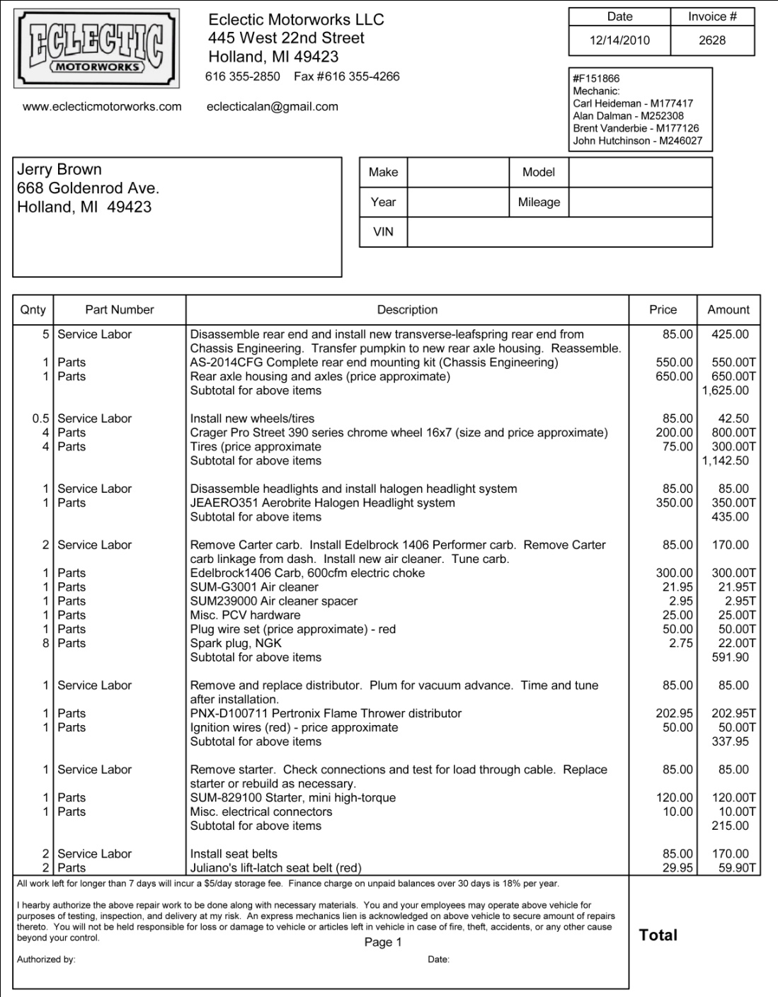
The Invoice
Provides the customer with pertinent information
Gives detailed record
Customer understands what s/he is paying for
Forces frequent communication and
accountability

Slide 13
My most important communication tool?
The Shop

Slide 14
The Shop
Clean (or at least well-organized)
No Chaos
Welcoming, ESPECIALLY employees
Can they understand how things work just by walking through?
Don’t forget the bathroom!

Slide 15
You can’t, overcommunicate with your customers!

Slide 16
Am I communicating too soon?
It is never too soon to communicate with your customer
You are never communicating too much
Try to have all the facts
Mistakes happen – communicate your mistakes as well as your success
Short, frequent works better than long, infrequent

Slide 17
More than half of communication is listening
Do you understand their goals and expectations?

Slide 18
everything a customer sees, hears or touches impacts their experience

Slide 19
The Eclectic Way
Phone or Email
Shop Visit
Car Drop-Off
Detailed, written evaluation
Agreement on Scope and Price

Slide 20
The Eclectic Way
Work Begins
Weekly Invoices
Phonecalls or shop visits at important milestones
Celebrations at Key Milestones
The Unveiling – Dramatic Impact at Completion of Work
Follow-up and Next Steps

Slide 21
Eclectic Don’ts
Interrupt, Answer Phone, Show Disinterest or Disrespect (Really, really listen)
Dirt or Dust on Cars
A Car is NOT a Shelf
Keys in Cars Outside or After Hours
Never Mess With the Radio, Mirrors, Seats
Blow Off a Visit

